Slide 1




Write Antifragile & Domain-Driven Tests with
QA
Smoke tests Exploratory tests End-to-end tests
Outside-in diamond TDD
contract tests
Integration tests
Acceptance tests
(Coarse-grained “unit” tests)
Thomas PIERRAIN @tpierrain (υѕe caѕe drιven)
unit tests
(Fine-grained)
THOMAS PIERRAIN (@TPIERRAIN)
Notes:
It’s one of my fav topic

Slide 2
Disclaimers
There is no silver bullet Your testing strategy & techniques must always be chosen accordingly to your context (both human & technical)
As long as you understand your trade-offs there is no reason not to explore new paths…
Thanks to Kent Beck, Martin Fowler, Michael Feathers, Nat Pryce & Steve Freeman for their great source of inspiration over the years #shouldersOfGiants
Notes:
After more than 15 years of TDD practice, we are describing here a testing strategy (outside-in diamond) that works amazingly well in many of our contexts (clients, domains , teams, cultures)

Slide 3
Prerequisites

Slide 4



A world of Tests
ET
Exploratory Tests (E2E)
IT
Integration Tests (Contract)
Different Types
AT
(coarse-grained unit) Acceptance Tests
THOMAS PIERRAIN (@TPIERRAIN)
UT
(fine-grained) Unit Tests

Slide 5

DDD loves…
E-commerce
BFF API
d
Booking API
d
d
d
U
d
U
Payment
Marketing
U
Accounts API
PSP API
Loyalty API
Central Reservation
d
CRS API
(Contextualized)
Services
Stay
d
U
U
U
Property Management System (PMS)
Revenue Mgmt
Distribution
THOMAS PIERRAIN (@TPIERRAIN)
Rates API
Resorts
Metasearch API
Notes:
Image : https://insights-images.thoughtworks.com/pairprogramming_f0d3ae7ef121e981e150bfcae4ecb995.jpg

Slide 6
DDD loves…
Our WeB API
HTTP
Infrastructure
Adapter
Domain
Ports & Adapters
Adapter
THOMAS PIERRAIN (@TPIERRAIN)
HTTP
API
Notes:
Image : https://insights-images.thoughtworks.com/pairprogramming_f0d3ae7ef121e981e150bfcae4ecb995.jpg

Slide 7
Why do I TDD

Slide 8
Why
Test Driven
development
Baby steps eradicate Procrastination and premature optimizations
Less debugging with Live testing tools
No regression
More relaxed
More efficient
More relevant
THOMAS PIERRAIN (@TPIERRAIN)
YAGNI ( Outside-in form )
Shared and clarified mental models
Notes:
Premature optimization: Split the make it work and the make it better
YAGNI: focus only on what really matter.
More relaxed – Against Procrastination and premature optimizations
More efficient – Progressive consolidation with baby steps
More relevant – Outside-in embraces YAGNI
Image: https://miro.medium.com/max/13440/1*o7WmwGkLVR0dVQUYqfSBeg.jpeg

Slide 9
Workflows

Slide 10
Outside-in
Test Driven
development
THOMAS PIERRAIN (@TPIERRAIN)
Notes:
Image: https://miro.medium.com/max/13440/1*o7WmwGkLVR0dVQUYqfSBeg.jpeg

Slide 11
Outside-in
Test Driven
development
AT
THOMAS PIERRAIN (@TPIERRAIN)
Notes:
Image: https://miro.medium.com/max/13440/1*o7WmwGkLVR0dVQUYqfSBeg.jpeg

Slide 12
Outside-in
Test Driven
development
AT
THOMAS PIERRAIN (@TPIERRAIN)
Notes:
Image: https://miro.medium.com/max/13440/1*o7WmwGkLVR0dVQUYqfSBeg.jpeg

Slide 13
Outside-in
Test Driven
development
AT
AT
THOMAS PIERRAIN (@TPIERRAIN)
Notes:
Image: https://miro.medium.com/max/13440/1*o7WmwGkLVR0dVQUYqfSBeg.jpeg

Slide 14
Outside-in
Test Driven
development
AT
AT
AT
THOMAS PIERRAIN (@TPIERRAIN)
Notes:
Image: https://miro.medium.com/max/13440/1*o7WmwGkLVR0dVQUYqfSBeg.jpeg

Slide 15
Outside-in
Test Driven
development
AT
AT
AT
AT
THOMAS PIERRAIN (@TPIERRAIN)
Notes:
Image: https://miro.medium.com/max/13440/1*o7WmwGkLVR0dVQUYqfSBeg.jpeg

Slide 16
Outside-in
Test Driven
development
AT
AT
AT
AT
AT
THOMAS PIERRAIN (@TPIERRAIN)
Notes:
Image: https://miro.medium.com/max/13440/1*o7WmwGkLVR0dVQUYqfSBeg.jpeg

Slide 17
Outside-in
Test Driven
development
AT
AT
AT
AT
AT
AT
THOMAS PIERRAIN (@TPIERRAIN)
Notes:
Image: https://miro.medium.com/max/13440/1*o7WmwGkLVR0dVQUYqfSBeg.jpeg

Slide 18
Outside-in
Test Driven
development
AT
AT
AT
AT
AT
AT
AT
THOMAS PIERRAIN (@TPIERRAIN)
Notes:
Image: https://miro.medium.com/max/13440/1*o7WmwGkLVR0dVQUYqfSBeg.jpeg

Slide 19
Inside-out
Test Driven
development
THOMAS PIERRAIN (@TPIERRAIN)
Notes:
Image: https://miro.medium.com/max/13440/1*o7WmwGkLVR0dVQUYqfSBeg.jpeg

Slide 20
Inside-out
Test Driven
development
UT
THOMAS PIERRAIN (@TPIERRAIN)
Notes:
Image: https://miro.medium.com/max/13440/1*o7WmwGkLVR0dVQUYqfSBeg.jpeg

Slide 21
Inside-out
Test Driven
development
UT
UT
API
THOMAS PIERRAIN (@TPIERRAIN)
Notes:
Image: https://miro.medium.com/max/13440/1*o7WmwGkLVR0dVQUYqfSBeg.jpeg

Slide 22
Inside-out
Test Driven
development
UT
UT
API
UT
THOMAS PIERRAIN (@TPIERRAIN)
Notes:
Image: https://miro.medium.com/max/13440/1*o7WmwGkLVR0dVQUYqfSBeg.jpeg

Slide 23
Inside-out
Test Driven
development
UT
UT
API
UT
THOMAS PIERRAIN (@TPIERRAIN)
UT
Notes:
Image: https://miro.medium.com/max/13440/1*o7WmwGkLVR0dVQUYqfSBeg.jpeg

Slide 24
Inside-out
Test Driven
development
UT
UT
API
UT
UT
THOMAS PIERRAIN (@TPIERRAIN)
UT
Notes:
Image: https://miro.medium.com/max/13440/1*o7WmwGkLVR0dVQUYqfSBeg.jpeg

Slide 25
Inside-out
Test Driven
development
UT
UT
API
UT
UT
THOMAS PIERRAIN (@TPIERRAIN)
UT
UT
Notes:
Image: https://miro.medium.com/max/13440/1*o7WmwGkLVR0dVQUYqfSBeg.jpeg

Slide 26
Inside-out
Test Driven
development
UT
UT
API
UT
UT
THOMAS PIERRAIN (@TPIERRAIN)
UT
UT
UT
Notes:
Image: https://miro.medium.com/max/13440/1*o7WmwGkLVR0dVQUYqfSBeg.jpeg

Slide 27
Inside-out
Test Driven
development
UT
UT
AT
API
UT
UT
THOMAS PIERRAIN (@TPIERRAIN)
UT
UT
UT
Notes:
Image: https://miro.medium.com/max/13440/1*o7WmwGkLVR0dVQUYqfSBeg.jpeg

Slide 28
Inside-out
Test Driven
development
AT
UT
UT
AT
API
UT
UT
THOMAS PIERRAIN (@TPIERRAIN)
UT
UT
UT
Notes:
Image: https://miro.medium.com/max/13440/1*o7WmwGkLVR0dVQUYqfSBeg.jpeg

Slide 29
Workflows
Test Driven
development
API
…
API
…
Outside-in
Inside-out
THOMAS PIERRAIN (@TPIERRAIN)
Notes:
Image: https://miro.medium.com/max/13440/1*o7WmwGkLVR0dVQUYqfSBeg.jpeg

Slide 30
Common pitfalls & mitigations

Slide 31

Test Driven
development
When we test Implementations instead of behaviours ; - (
Because We tend to overlook some boring but crucial areas ( like adapters code )
1. Fragile tests
2. Blind spots
3. Complex setups
When ( Unit x Integration )
Test coverage is not enough
Beware of…
THOMAS PIERRAIN (@TPIERRAIN)
cognitive overload reduces stamina
and engagement
Notes:
Cognitive overload reduce stamina ➔ Pit of failure. Like a broken window syndrome.
https://www.welcometothejungle.com/en/articles/cognitive-overload-at-work
Image : https://encrypted-tbn0.gstatic.com/images?q=tbn:ANd9GcRUkEI7a62LZWV7URYcN5jClByl0GkP6ReZvA&usqp=CAU
I could have added
Non deterministic
The team must be confident in their tests
Fragile tests / Painful Refactoring
Messy test code
Slowness
Non deterministic

Slide 32
Test Driven
development
API
uses
uses
1.
Beware of… Fragile tests

Slide 33
Test Driven
development
AT
AT
UT
API
UT
uses
UT
1.
Beware of… Fragile tests
UT
THOMAS PIERRAIN (@TPIERRAIN)
UT
UT

Slide 34
Test Driven
development
AT
AT
UT
API
Now we want to change our implementation here
UT
uses
UT
1.
Beware of… Fragile tests
UT
THOMAS PIERRAIN (@TPIERRAIN)
UT
UT

Slide 35
Test Driven
development
AT
AT
UT
API
UT
uses
UT
1.
Beware of… Fragile tests
UT
THOMAS PIERRAIN (@TPIERRAIN)
UT
UT

Slide 36
Test Driven
development
AT
AT
UT
😕
API
UT
😕
uses
UT
1.
Beware of… Fragile tests
😕
UT
😕
😕
😕
THOMAS PIERRAIN (@TPIERRAIN)
UT
UT

Slide 37
Test Driven
development
AT
AT
UT
😕
API
UT
😕
uses
UT
Fragile tests
➔ Less refactoring
UT
😕
😕
😕
THOMAS PIERRAIN (@TPIERRAIN)
UT
UT

Slide 38
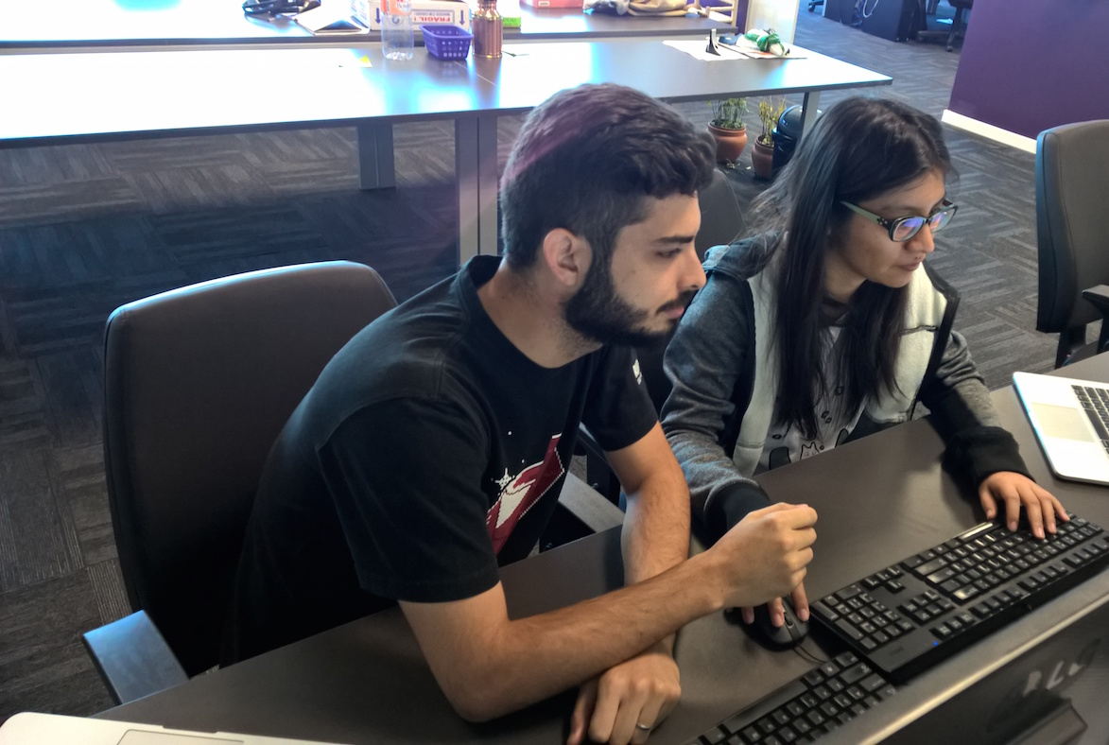
Test Driven
development
Disclaimer
Test Coverage will be a visual help to identify blind spots in our code here.
It doesn’t mean that test coverage is a must as KPI.
2.
Beware of… Blind Spots
THOMAS PIERRAIN (@TPIERRAIN)
Notes:
Image : https://insights-images.thoughtworks.com/pairprogramming_f0d3ae7ef121e981e150bfcae4ecb995.jpg

Slide 39
Test Driven
development
Our WeB API
HTTP
Infrastructure
Adapter
Domain
2.
Beware of… Blind Spots
Adapter
HTTP
API
THOMAS PIERRAIN (@TPIERRAIN)
Notes:
Image : https://insights-images.thoughtworks.com/pairprogramming_f0d3ae7ef121e981e150bfcae4ecb995.jpg

Slide 40
Test Driven
development
Test the domain code with { acceptance | unit tests }
Domain
2.
Beware of… Blind Spots
THOMAS PIERRAIN (@TPIERRAIN)
Notes:
Image : https://insights-images.thoughtworks.com/pairprogramming_f0d3ae7ef121e981e150bfcae4ecb995.jpg

Slide 41
Test Driven
development
Test the domain code with { acceptance | unit tests }
Adapter
Domain
2.
Beware of… Blind Spots
Adapter
HTTP
Test the infra code (i.e. Adapters) with contract (integration) tests
API
THOMAS PIERRAIN (@TPIERRAIN)
Notes:
Image : https://insights-images.thoughtworks.com/pairprogramming_f0d3ae7ef121e981e150bfcae4ecb995.jpg

Slide 42

Test Driven
development
As DEV we
to write Domain tests
AT
AT
AT
AT
AT
AT
AT
AT
AT
AT
AT
AT
Domain
AT
AT
AT
100% covered
by Acceptance Tests
Stub
HTTP
2.
Beware of… Blind Spots
API
As DEV we don’t write enough integration tests
Because they are slow to run & boring
➔
Right Adapter
80%
BUG
BUG
IT
IT
IT
⬄
IT
THOMAS PIERRAIN (@TPIERRAIN)
Contract tests
BUGS
Stub
Notes:
Image : https://insights-images.thoughtworks.com/pairprogramming_f0d3ae7ef121e981e150bfcae4ecb995.jpg

Slide 43
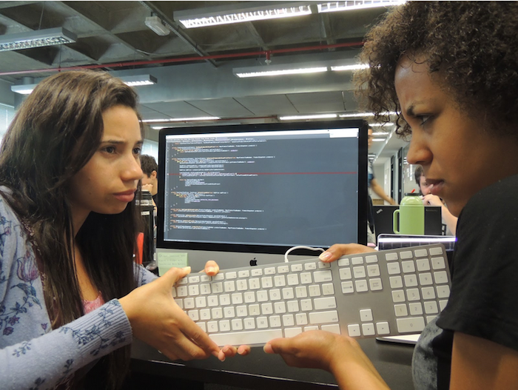
Test Driven
development
3.
Beware of… Complex setups
THOMAS PIERRAIN (@TPIERRAIN)
Notes:
Image: https://insights-images.thoughtworks.com/1020ways20pair20programming201_ac7561ab53c005c72dd42a76dcc238a9.png

Slide 44
Test Driven
development
1. Fragile tests
2. Blind spots
3. Complex setups
Beware of…
THOMAS PIERRAIN (@TPIERRAIN)
Notes:
Cognitive overload reduce stamina ➔ Pit of failure. Like a broken window syndrome.
https://www.welcometothejungle.com/en/articles/cognitive-overload-at-work
Image : https://encrypted-tbn0.gstatic.com/images?q=tbn:ANd9GcRUkEI7a62LZWV7URYcN5jClByl0GkP6ReZvA&usqp=CAU
I could have added
Non deterministic
The team must be confident in their tests
Fragile tests / Painful Refactoring
Messy test code
Slowness
Non deterministic

Slide 45
Test Driven
development
When we test Implementations instead of behaviours ; - (
Because We tend to overlook some boring but crucial areas ( like adapters code )
1. Fragile tests
2. Blind spots
3. Complex setups
When ( Unit x Integration )
Test coverage is not enough
Beware of…
THOMAS PIERRAIN (@TPIERRAIN)
cognitive overload reduces stamina
and engagement
Notes:
Cognitive overload reduce stamina ➔ Pit of failure. Like a broken window syndrome.
https://www.welcometothejungle.com/en/articles/cognitive-overload-at-work
Image : https://encrypted-tbn0.gstatic.com/images?q=tbn:ANd9GcRUkEI7a62LZWV7URYcN5jClByl0GkP6ReZvA&usqp=CAU
I could have added
Non deterministic
The team must be confident in their tests
Fragile tests / Painful Refactoring
Messy test code
Slowness
Non deterministic

Slide 46
Outside-in Diamond

Slide 47




Checking In real life…
All real systems involved May be Manual sometimes
To this
QA
Smoke tests Exploratory tests End-to-end tests
From this
contract tests
Integration tests
Are we still compliant with…?
Some real systems involved
Ensure that Stubs ⬄ Real systems
It all starts here…
Outside-in TDD
Behavioural & Domain-Driven
Bloody Fast
Autonomous & Concise (builders & Fuzzers to setup)
NO I/O ➔ “last miles” stubs
Deterministic & Isolated
The outer loop
Start Here
Acceptance tests
(Coarse-grained “unit” tests)
unit tests
(Fine-grained)
For complex parts only
Behavioural & Domain-Driven
Bloody Fast
Deterministic & Isolated
The inner (optional) loop
testing gem: Why outside-in diamond is now our favorite testing strategy @

Slide 48
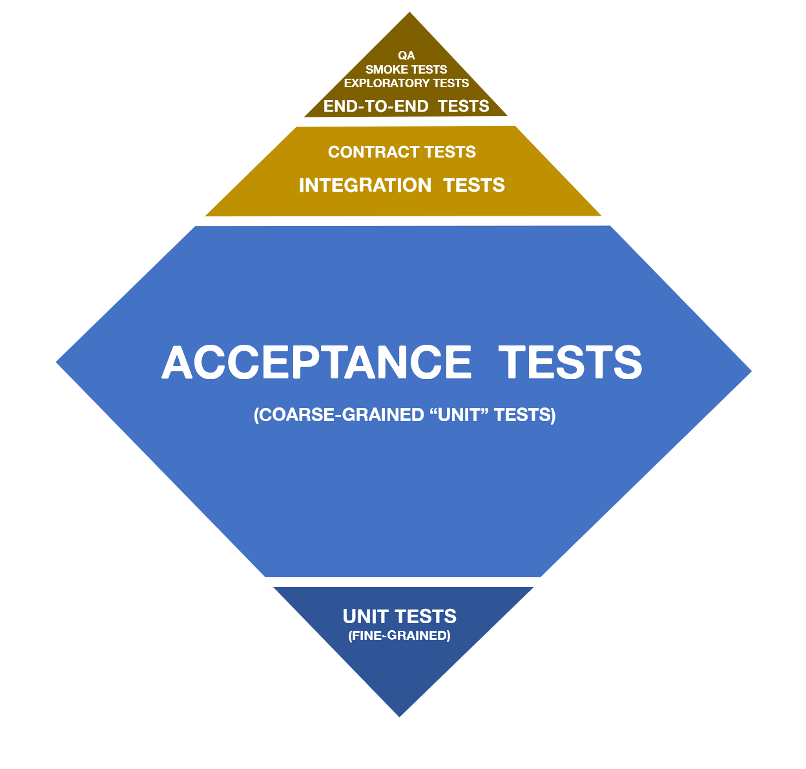
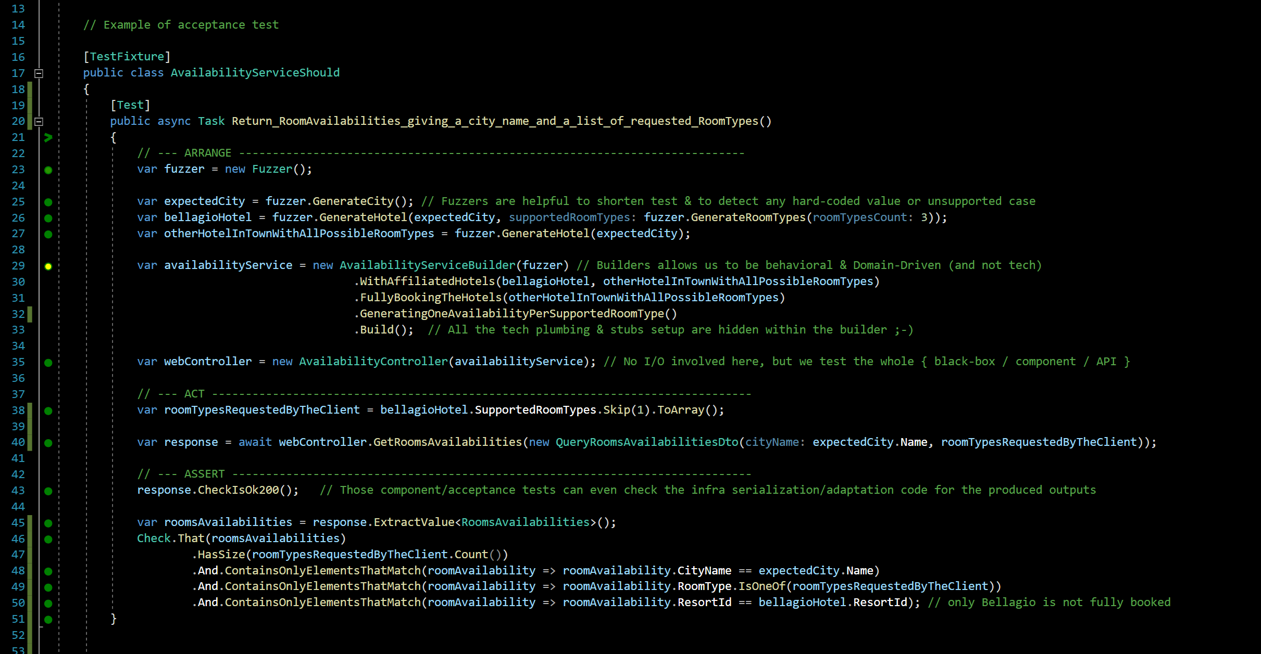
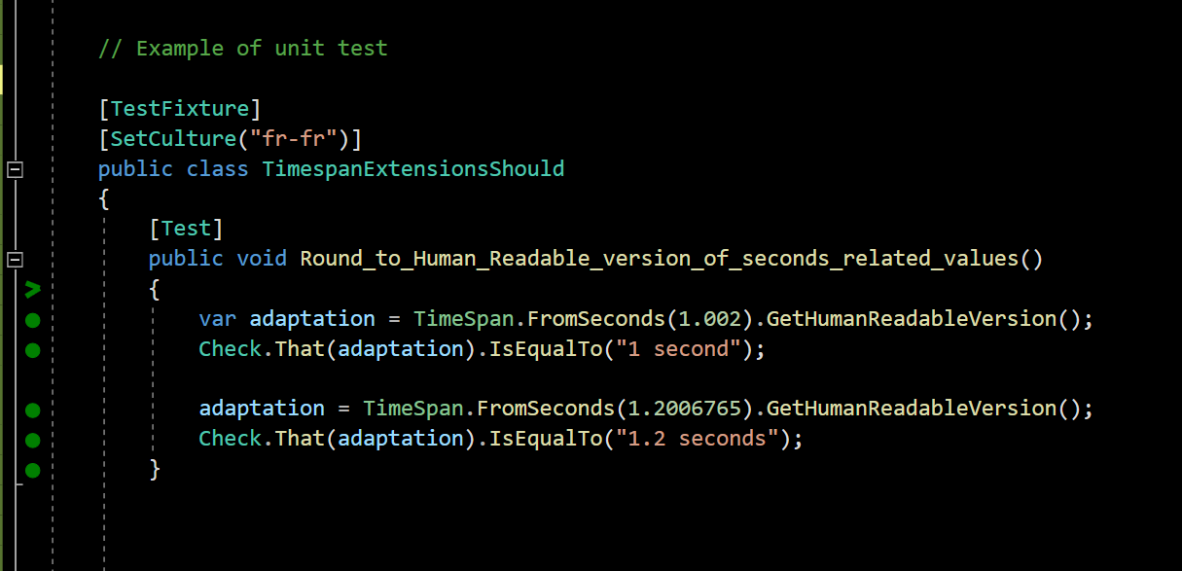
Can you Give me an example?
testing gem: Why outside-in diamond is now our favorite testing strategy @

Slide 49
What you test is what you ship…
No more bad surprises in situation >> everything is tested assembled
no more code plumbing leaks >> Our Acceptance tests cover everything (but I/O)
complementary contract (integration) tests >> A guarantee that the stubs we use to speed our Acceptance tests are faithful to reality
WHY
Easier for Junior DEVs
They are More focused on the system behaviors >> it Enforces Yagni
They code less fragile tests (no more implementation tests) >> it Eases merciless Refactoring
How
Specific Outside-in TDD
Double loop ➔ one and a half loop instead (Fine-grained unit tests only whenever facing difficulties)
Still Baby steps FTW!
only the external systems are stubbed
Acceptance tests cover adapters code too! (only the adaptation code in action, not its I/O)
Behavioural and domain-driven tests (DDD Ubiquitous language)
Blazing-fast acceptance tests
But…
…What about
Combinatory explosion of test cases?!? ➔lots of concise & easy to write acceptance tests (powered by fuzzers) were more than sufficient in 85% of our xp
Surgical identification of bug spots?!? ➔ no big deal actually. very episodically, You just debug your reproductible acceptance test and… TADA! (this point was just cargo-cult psychological barrier)
Friendly patterns & tools
DDD & Hexagonal architecture
Builders & Fuzzers for acceptance tests setup
live-testing tools
Dev people dislike to write enough integration tests (vs. unit ones). This explains lots of Blind Spots & Failures of classical test strategies
➔ We've tradeoff former approaches (UT x IT) in favor of safeness in production whatever the vigilance of the dev team
testing gem: Why outside-in diamond is now our favorite testing strategy @
Notes:
Blind spots of lots of test strategies is due to the fact that dev doesn’t take lot of time to code integration tests (vs. unit ones)
We trade off former approaches (UT x IT) in favor of quietness in production whatever the dev team.
Realizing that We realized that dev took more time to unit test than to integration tests
Dev dedicate a lot more times to unit test than integration tests

Slide 50
Binary is for machine Code is for people We care people
Special thanks to: Cyrille DUPUYDAUBY & Rui CARVALHO for their kind reviews & feedbacks

Slide 52

Notes:
Image: https://miro.medium.com/max/7788/1*0aU36QSwzY0no7XEjoyM7g.jpeg

Slide 53
Notes:
Image: https://insights-images.thoughtworks.com/1020ways20pair20programming201_ac7561ab53c005c72dd42a76dcc238a9.png

Slide 54
Outside-in?
Test Driven
development
AT
AT
UT
UT
AT
AT
API
AT
UT
THOMAS PIERRAIN (@TPIERRAIN)
UT
Notes:
Image: https://miro.medium.com/max/13440/1*o7WmwGkLVR0dVQUYqfSBeg.jpeg

Slide 55
Test Driven
development
AT
AT
AT
AT
AT
AT
AT
AT
AT
AT
AT
AT
Domain
AT
AT
AT
100% covered
by Acceptance Tests
2.
Beware of… Blind Spots
Stub
BUG
IT
Right Adapter
Because integration tests are slow & boring ➔
IT
80%
IT
BUG
IT
THOMAS PIERRAIN (@TPIERRAIN)
HTTP
Left Adapter
80%
IT
API
IT
BUG
IT
Notes:
Image : https://insights-images.thoughtworks.com/pairprogramming_f0d3ae7ef121e981e150bfcae4ecb995.jpg

